Slide 1

Fast Food Analysis
Diagnostic Dashboard
PTID-CDA-MAY-25-491
CDACL-004-FASTFOOD ANALYSIS
VINAY KUMAR JAISWAL

Slide 2










CONTENTS
Objectives
Data Collection
Data Preprocessing
Data Visualization
a .Donut Chart
b . Column Chart
c . Waterfall Chart
d . Matrix Table & Slicer card
Conclusion & Recommendation

Slide 3
OBJECTIVE
Goal: Analyze Nutritional & Healthy data from fast food chains
Deliverables:
Diagnostic insights.
Interactive Power BI dashboard.
Recommendations.

Slide 4
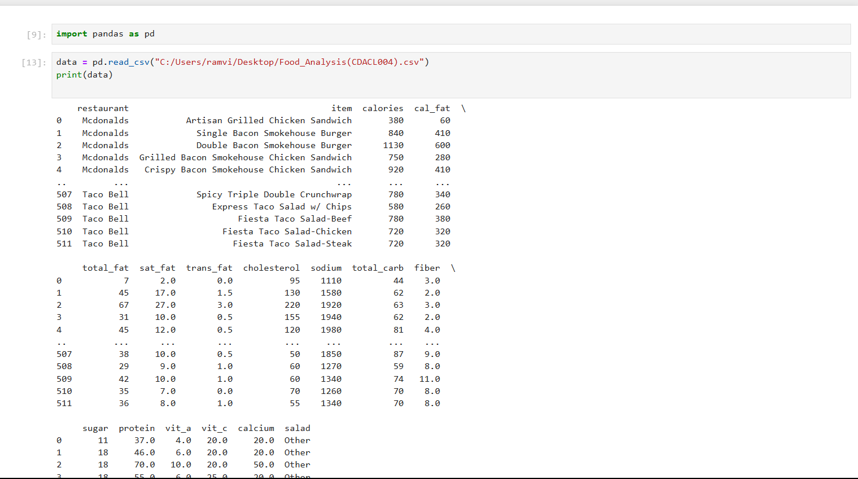
DATA COLLECTION
Data collection is crucial for making informed decisions, conducting research, and analyzing trends.

Slide 5
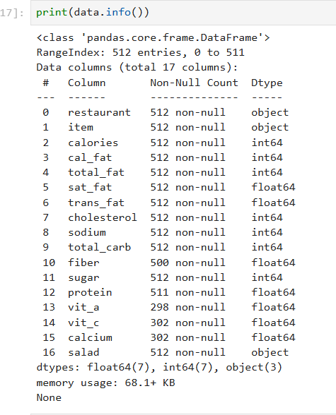
DATA PREPROSSING
The process of transforming raw data into a format that is suitable for analysis and modeling.
To Check Data Structure.

Slide 6
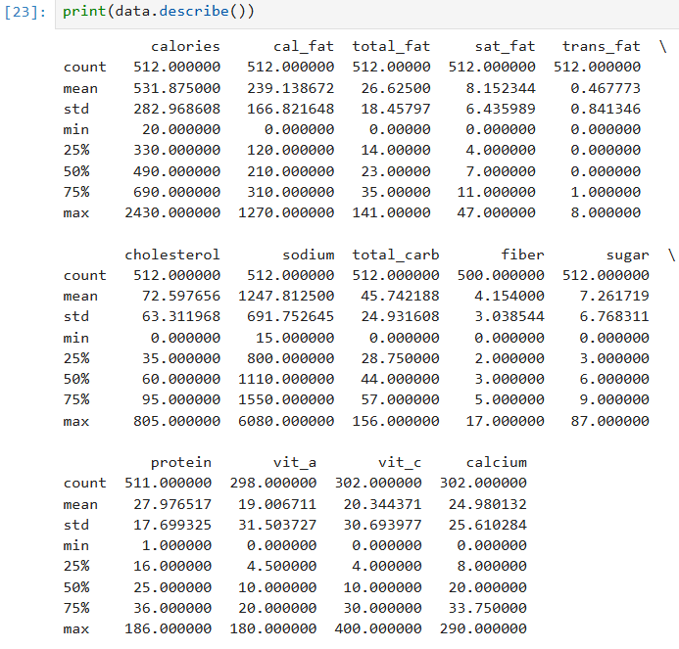
Describe Data.

Slide 7
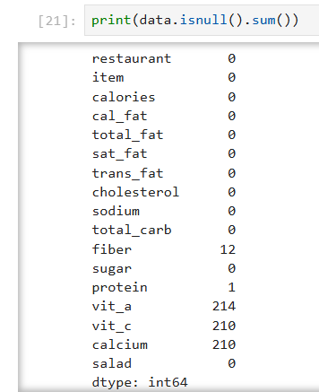
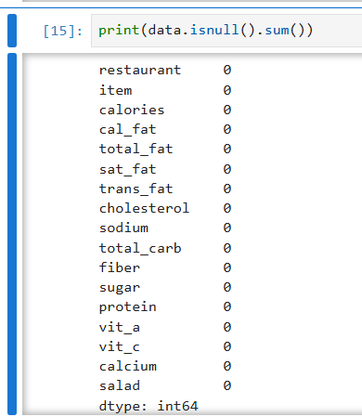
Checking a Null Values
Replacing missing value with Mean of each column.
BEFORE AFTER

Slide 8
Add New Column
By using the help of New column (POWER BI).
1.NUTRITION STATUS
2.HEALTHY STATUS

Slide 9
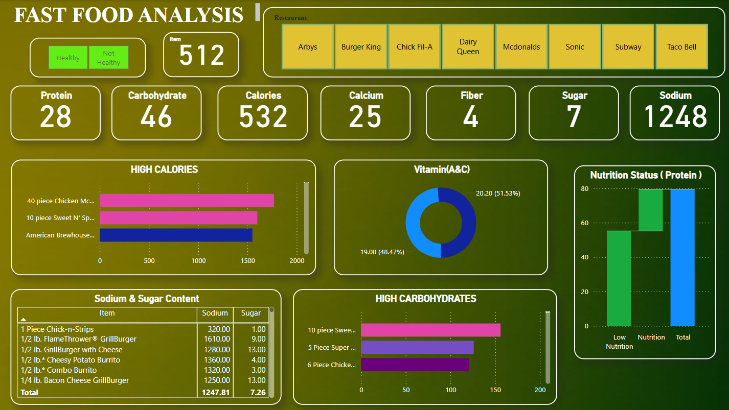
DATA VISUALIZATION

Slide 10
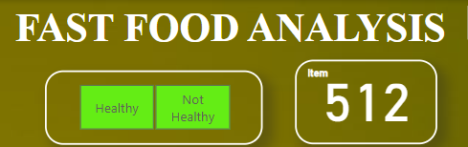
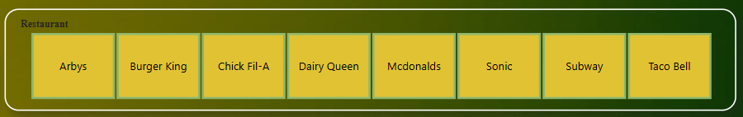
Data visualization is the graphical representation of information and data.
Slicer Card
It is a visual tool that allows users to filter report data interactively by selecting values displayed as individual cards or tiles.

Slide 11
Card
A Card in Power BI is a simple visual used to display a single value typically a key metric, such as total sales, profit, count, or average. It’s designed to highlight important figures in a clean and easy-to-read format.
Average of Protein.
Average of Carbohydrate.
Average of Calories.
Average of Calcium.
Average of Fiber.
Average of Sugar.
Average of Sodium.

Slide 12
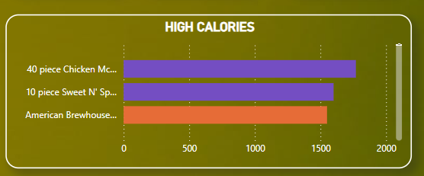
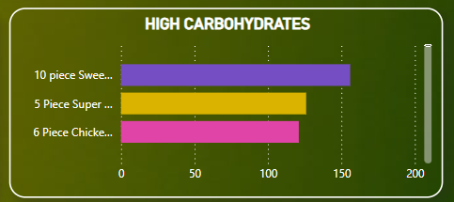
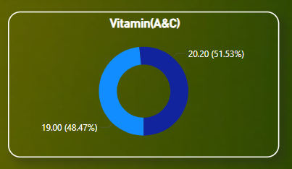
Bar chart
It is a graphical representation of data that uses rectangular bars to display categorical data.
This bar chart highlights food items with the highest carbohydrate content, allowing quick comparison to identify items with the greatest carb load.
Donut Chart
It is used to show proportional data or percentage contribution of categories to a whole.

Slide 13
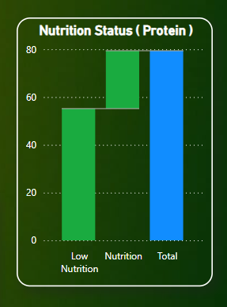
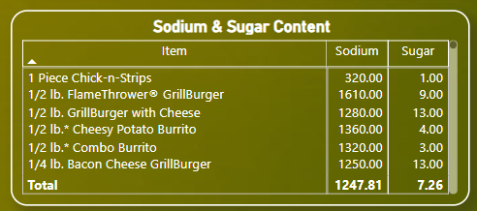
Waterfall chart
It is a type of visualization that shows how an initial value is affected by a series of intermediate positive or negative values, leading to a final result.
The green bars represent incremental changes, while the blue bar represents the final total protein level.
Matrix Table
It is visual table that allows you to display data in a pivot-table format, similar to an Excel PivotTable.
This matrix table displays the sodium and sugar content of various food items, enabling easy comparison and highlighting total intake values for better nutritional insights.

Slide 14
Conclusion & Recommendation
This diagnostic analysis reveals clear nutritional imbalances in many fastfood items.
These insights support data-driven improvements in menu planning and public health awareness.
Reduce Excess Nutrients.
Expand Healthy Offerings.
Reduce Sodium & Saturated Fat.

Slide 15


